Slide 1
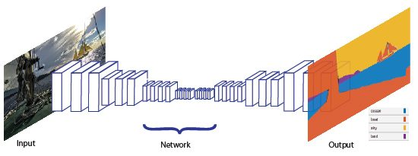
CNN for image segmentation

Slide 2
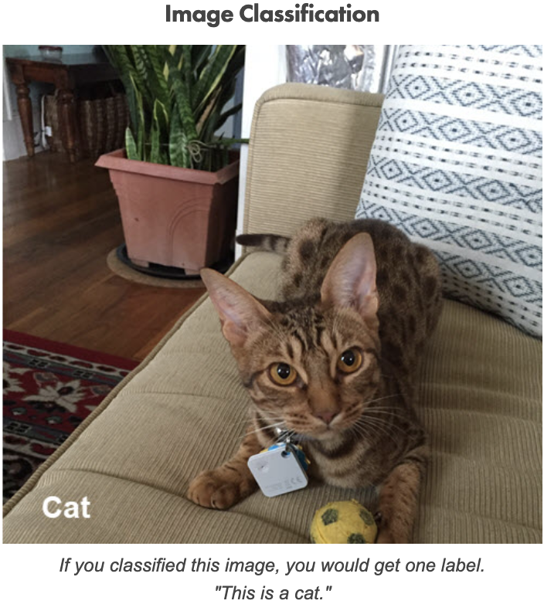
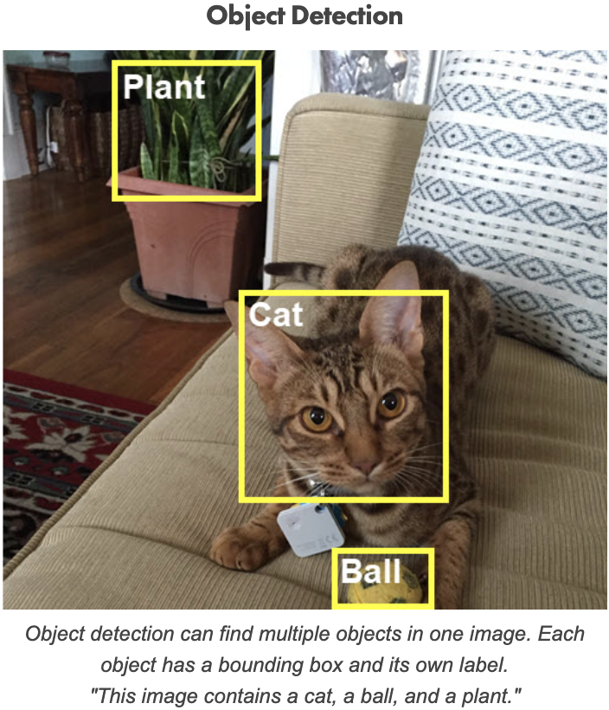
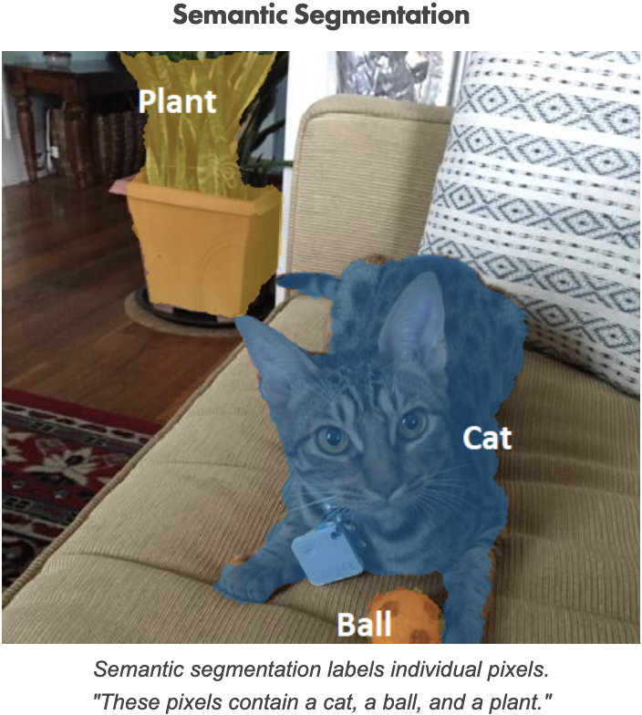
Computer Vision Applications
Computer vision works through visual recognition techniques such as:
Image Classification
Associate the image with a class such as “people”, “animals”, “cars” etc.
Object Detection
Identify the objects in the image with a bounding box and associate each of them with a specific class
Image Segmentation
Identify parts of the image and understanding what object they belong to
Image Classification
Object Detection
Image Segmentation
Notes:
Introduction to computer vision applications in order to focus on image segmentation task

Slide 3
Image Segmentation
Image segmentation involves splitting an image into segments. Each of them represents objects or parts of objects and comprises sets of pixels. There are two categories of image segmentation:
Semantic Segmentation
Aims to clustering parts of an image together that belong to the same meaningful class of objects. It is a form of pixel-level classification because each pixel in an image is associated with a category
Instance Segmentation
Detect each distinct object of interest in an image. It differs from semantic segmentation in that it doesn’t classify every pixel
Image segmentation
Notes:
Explain what is image segmentation and its specializations

Slide 4
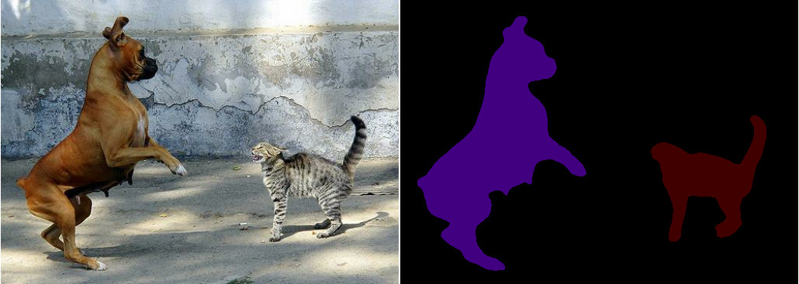
From classification to segmentation
The first CNN-based approach involved the use of a pre-trained CNN for classification tasks. Specifically, the classification layer is replaced with a new layer whose purpose is to make a class prediction for each pixel
Notes:
First approach CNN-based: from classification to image segmentation

Slide 5
CNN for image segmentation
Subsequently, new architectures were built specifically for the purpose based on encoder/decoder structure
ENCODER
DECODER
E
The encoder downsamples the spatial resolution of the input, developing lower-resolution feature mappings which are learned to be highly efficient at discriminating between classes
The decoder upsamples the feature representations into a full-resolution segmentation map
Notes:
Encoder/Decoder architectures developed specifically for image segmentation. The classification-based approach is deprecated due to the high performance of autoencoder-based approaches.

Slide 6
Evaluation Metrics for image segmentation
We usually classify our predictions into true positives, true negatives, false positives, and false negatives. However, for the dense prediction task of image segmentation, it's not immediately clear how we can evaluate our predictions. Intuitively, a successful prediction is one that maximizes the overlap between the predicted and true objects. The following are the most used metrics:
Pixel Accuracy
Intersection-over-Union (Jaccard index)
Dice similarity index (F1 score)
Notes:
Different metrics can be used to evaluate predictions

Slide 7
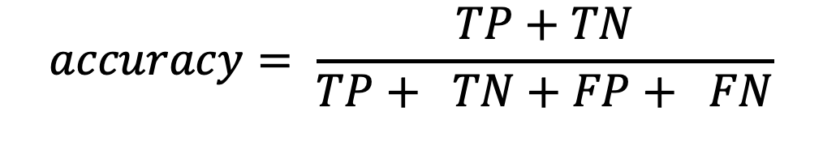
Pixel Accuracy
The easiest metric to evaluate a semantic segmentation is to simply report the percent of pixels in the image which were correctly classified. However, it is not the best metric due to poor performance in a class imbalanced problem
$$accuracy= \frac{TP+TN}{TP+ TN+FP+ FN}$$
Notes:
Accuracy is the easiest metric. The imbalanced classes typically refers to a problem where the classes are not equally represented.

Slide 8
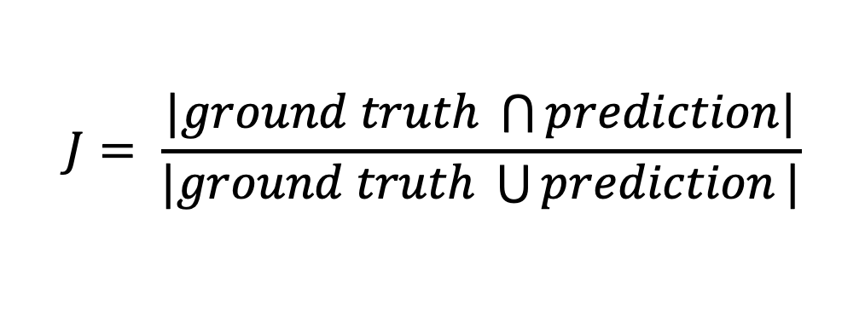
Intersection-over-Union ( Jaccard Index )
The Jaccard index is essentially a method to quantify the area of overlap between the ground truth and predicted segmentation
$$J= \frac{|ground truth \bigcap{prediction|}}{|ground truth \bigcup{prediction}|}$$
Notes:
The Jaccard Index is a metric used to understand the similarities between sample sets.

Slide 9
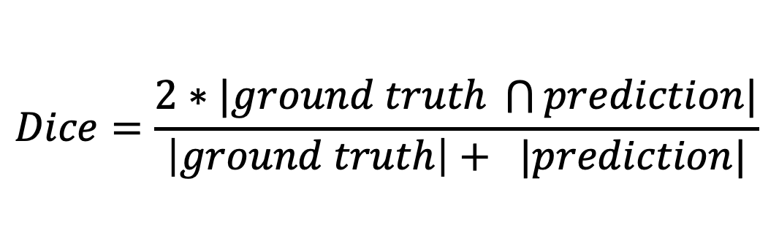
Dice similarity index (F1 score)
Dice similarity coefficient is a spatial overlap index, a metric that is used to measure the similarity of two samples
2 x
$$Dice=\frac{2∗|ground truth \bigcap{prediction|}}{\left|ground truth\right|+ |prediction|}$$
+
Notes:
The Dice similarity index is a measure of overlap used to assess segmentation performance

